Slide 1


2019
Netcoreconf
Securing .Net Core APIs and WebApps with Azure Active Directory
Luis Mañez
Cloud Architect – ClearPeople LTD
@luismanez
26/01/2018

Slide 2

Securing .Net Core APIs and WebApps with Azure Active Directory

Slide 3
Sponsors

Slide 4


The Scenario
Sambori is a Toys manufacturing company that wants to allow their employees to Submit and Manage their expenses through different Apps.
They also need a tool for some Business users to manage and approve the different expenses.

Slide 5

The requirements
As a User, I want to be able to Submit my Expenses
As a User, I want to be able to see all my Expenses
As an Approver, I want to see all the Expenses in the system
As an Approver, I want to be able to approve or decline Expenses from any user
As an Admin, I want to see all the Expenses in the system
As an Admin, I want to be able to approve or decline Expenses from any user
As an Admin, I want to be able to Delete expenses from the system

Slide 6



The Users
Mary Jane Watson
IT Manager
Norman Osborn
Finance Accountant
Felicia Hardy
Sales

Slide 7


Solution Architecture
Azure Active Directory
Expenses Management
Web App
Expenses
graph.microsoft.com
End Users
WebAPI
Expenses
Lite
Web App

Slide 8


The Protocols
oAuth2
Provides Authorization framework
OpenIdConnect
Built on top of oAuth 2
Provides Authentication capabilities
/UserInfo endpoint
IdToken
Discovery service
/Authorize endpoint
Access Token
/Token endpoint
Refresh Token

Slide 9









The Players
Client (AKA App)
Public: native, mobile, user agent
Confidential: server
Authorization Server
Resource Owner
(AKA User)
Resource Server

Slide 10
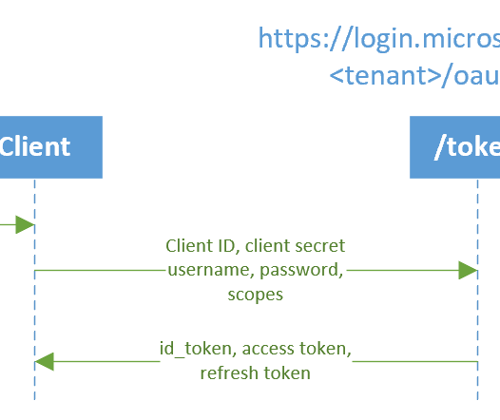
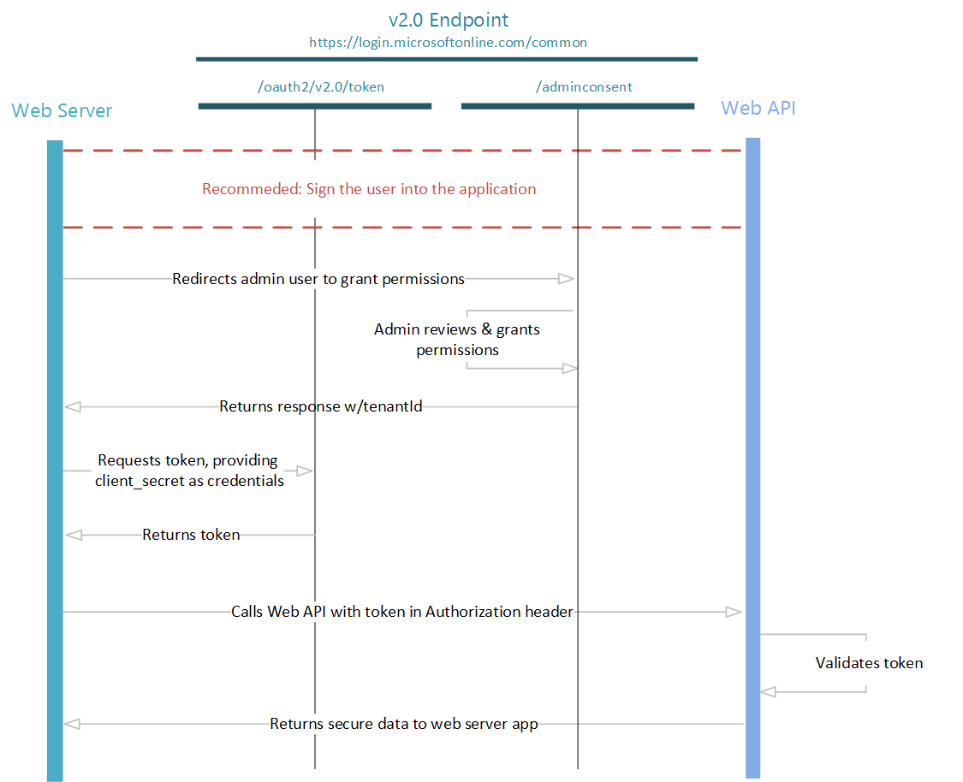
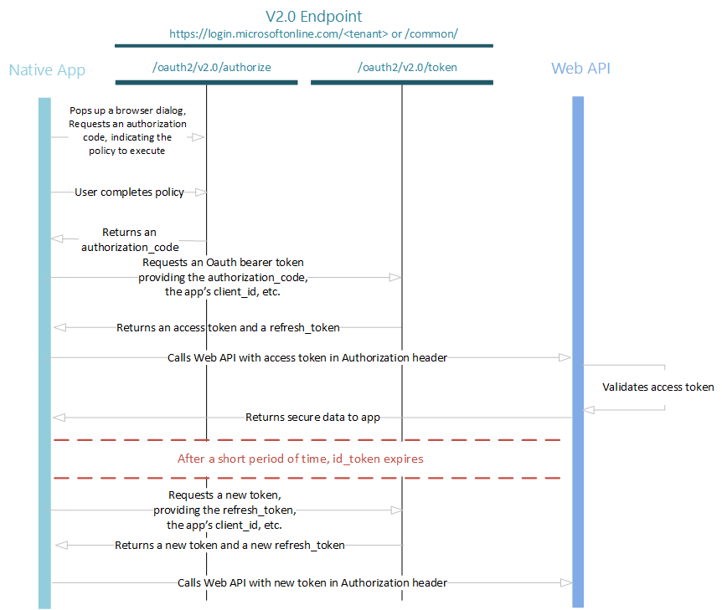
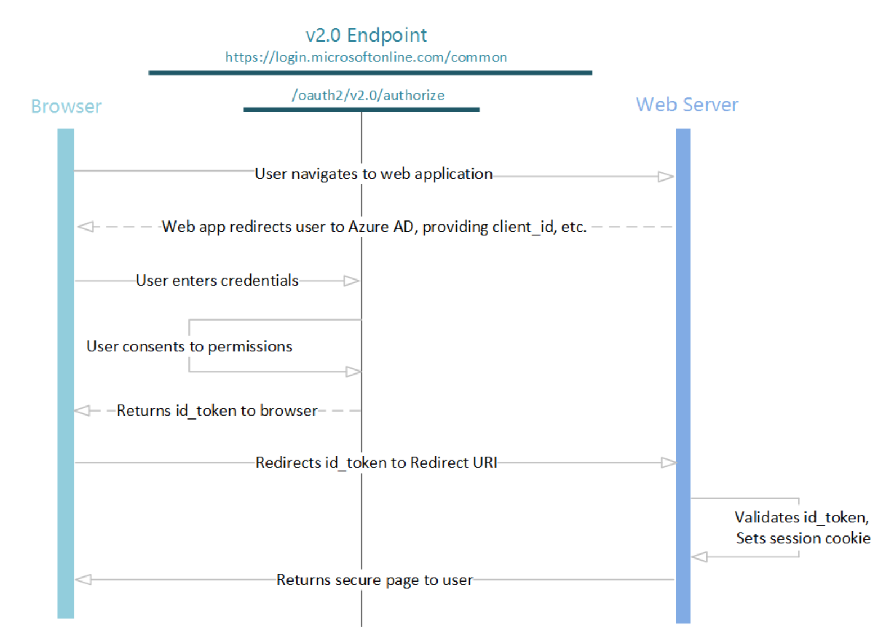
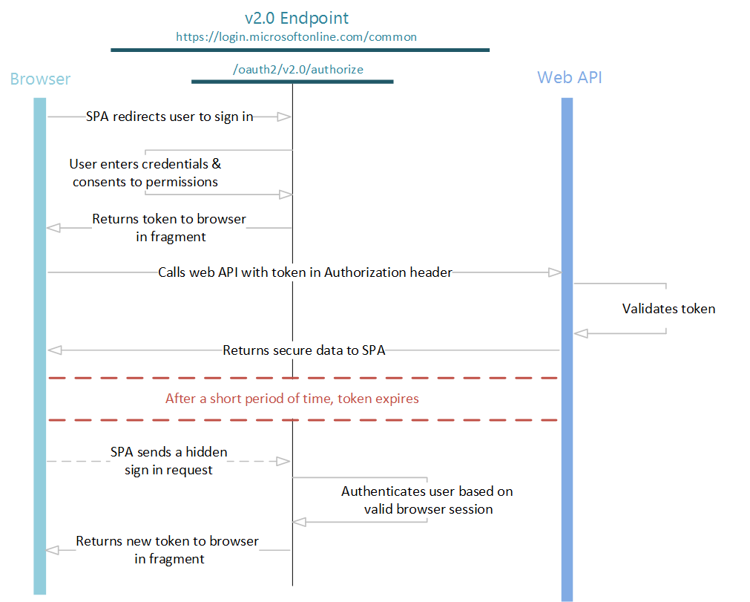
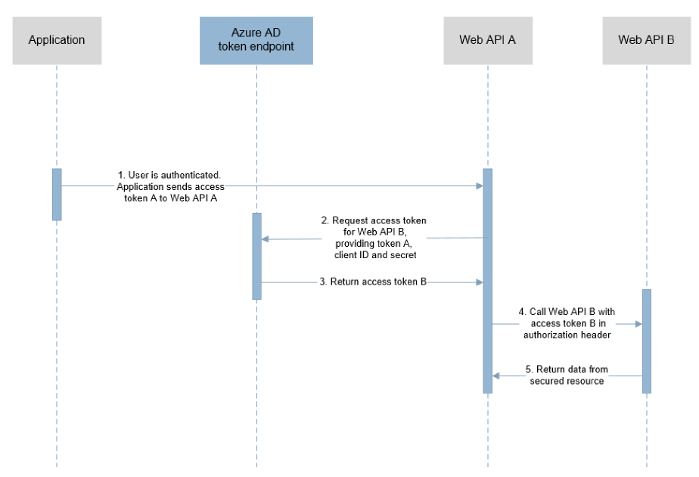
The Flows in Azure AD v2
Open ID Connect (Sign in) Flow
OAuth 2.0 Auth code grant
OAuth 2.0 Implicit grant
Oauth 2.0 On-behalf-of
Oauth 2.0 Client Credentials
Oauth 2.0 Resource Owner password credentials grant
Refresh Token
Device Code Flow (personal accounts NOT supported)

Slide 11
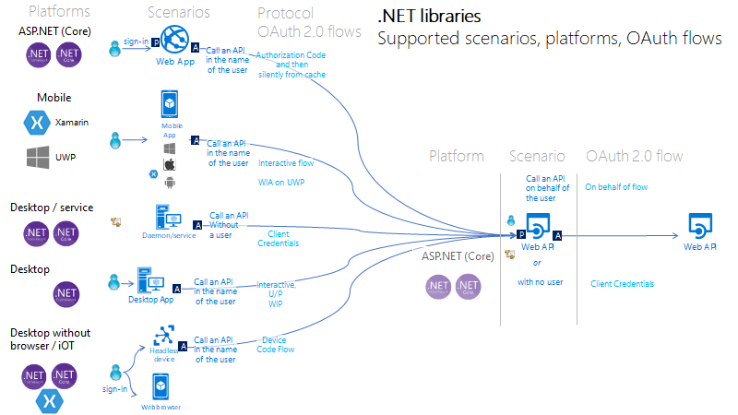
https://github.com/AzureAD/microsoft-authentication-library-for-dotnet/wiki/scenarios

Slide 12
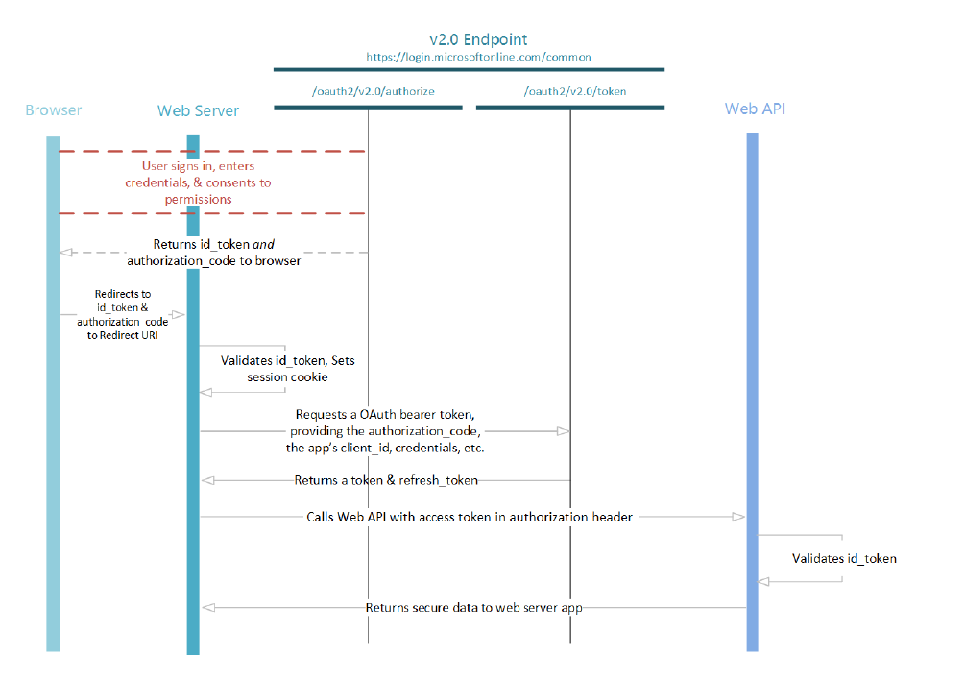
Azure AD Sign In Flow

Slide 13
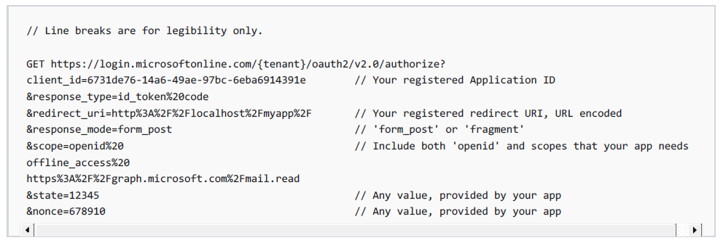
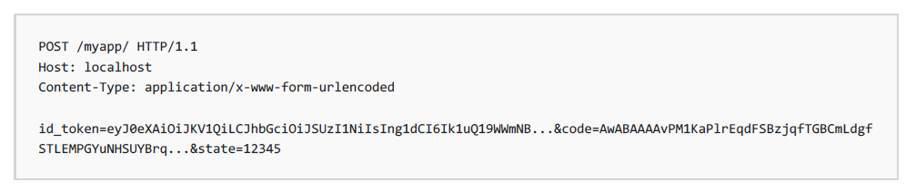
Azure AD Sign In Flow

Slide 14
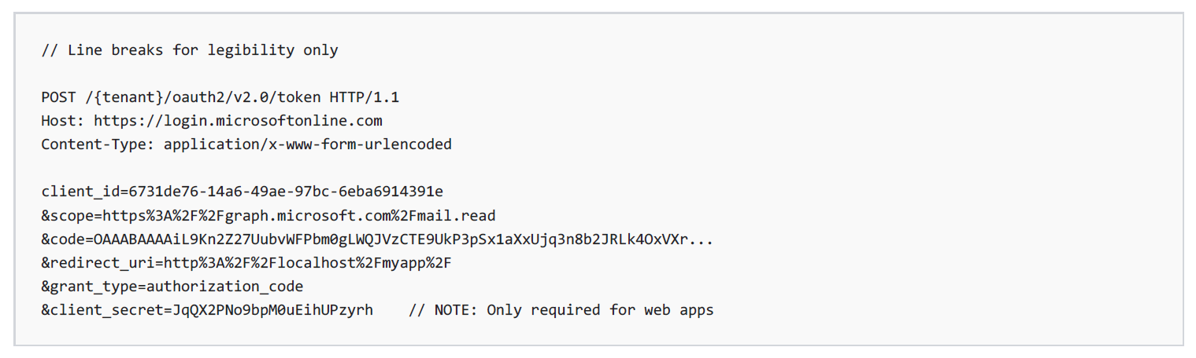
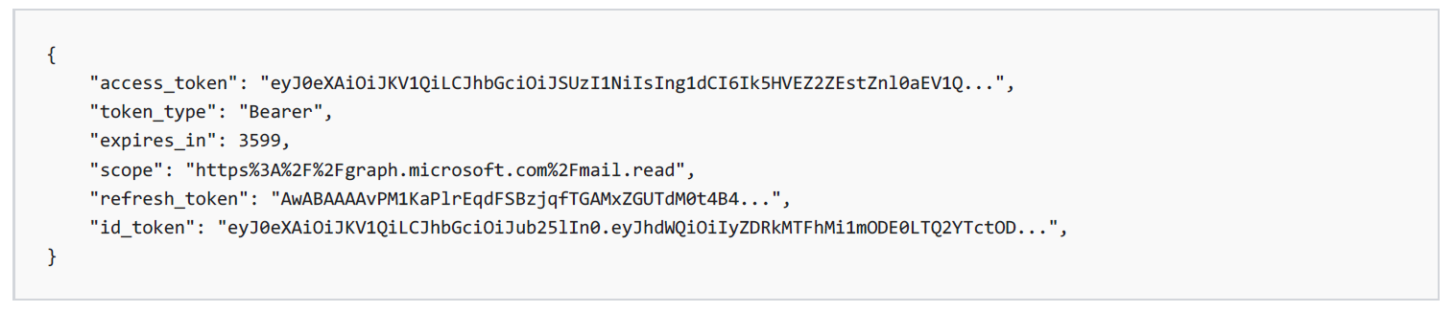
Azure AD Authorization Code Flow

Slide 15
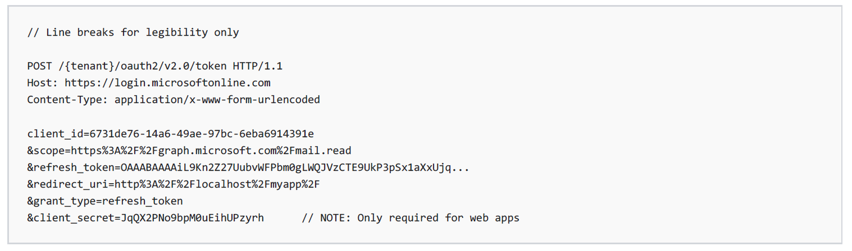
Azure AD Refresh Token

Slide 16
Azure AD On-Behalf-Of Flow

Slide 17
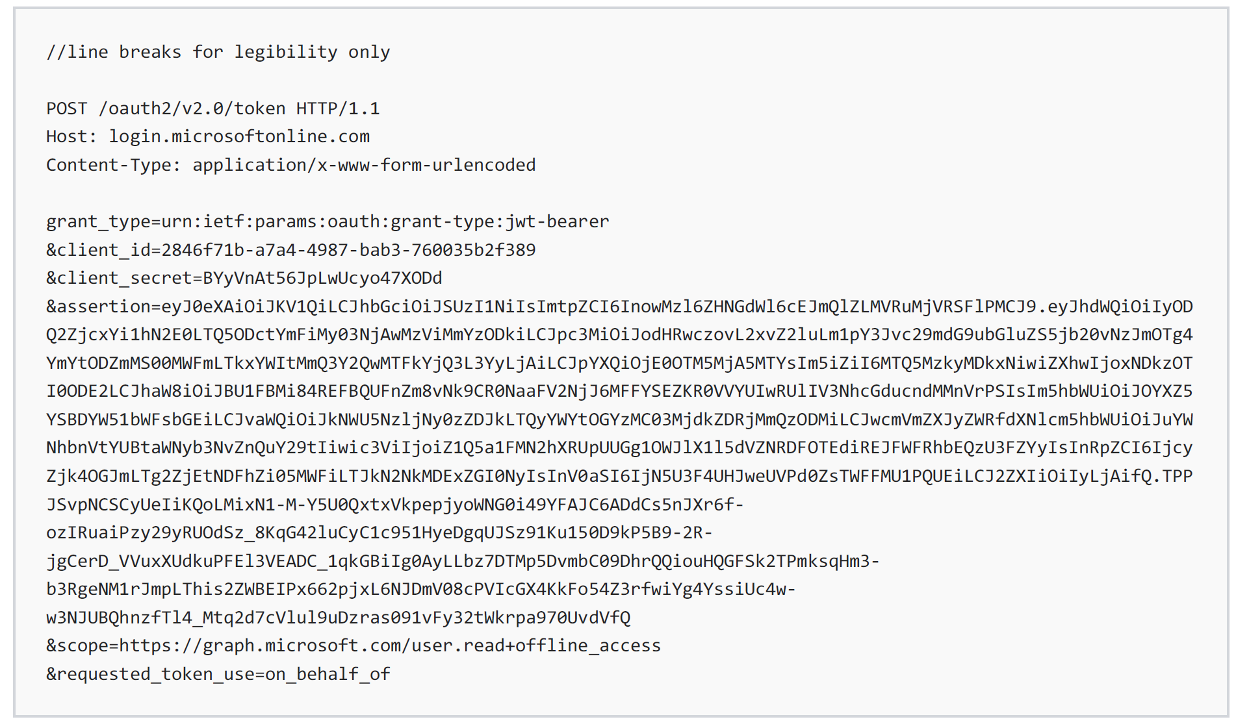
Azure AD On-Behalf-Of Flow

Slide 18
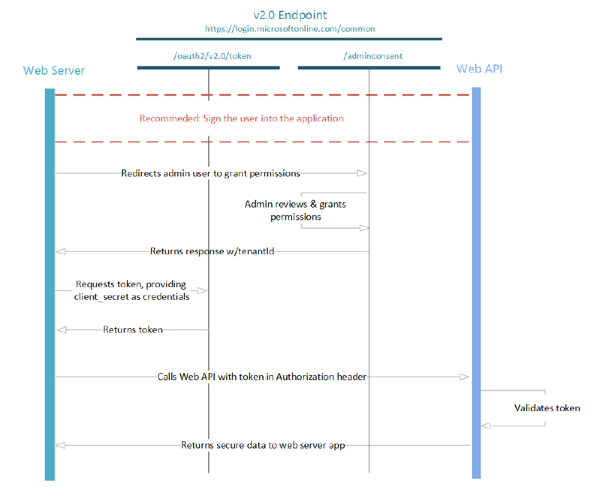
Azure AD Client Credentials Flow

Slide 19
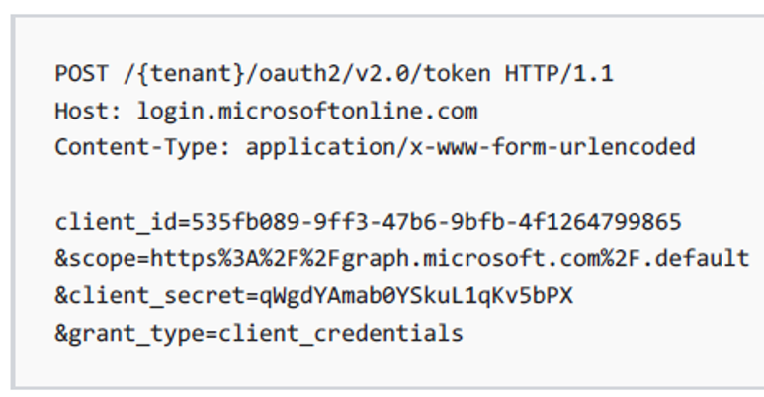
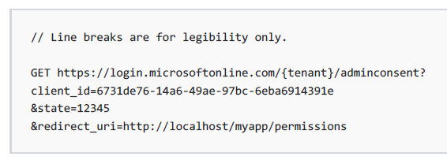
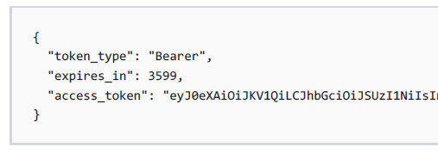
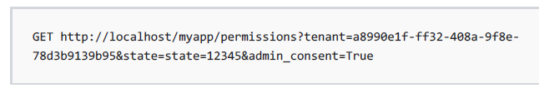
Azure AD Client Credentials Flow
Get Token
Admin consent
No Refresh Token!

Slide 20
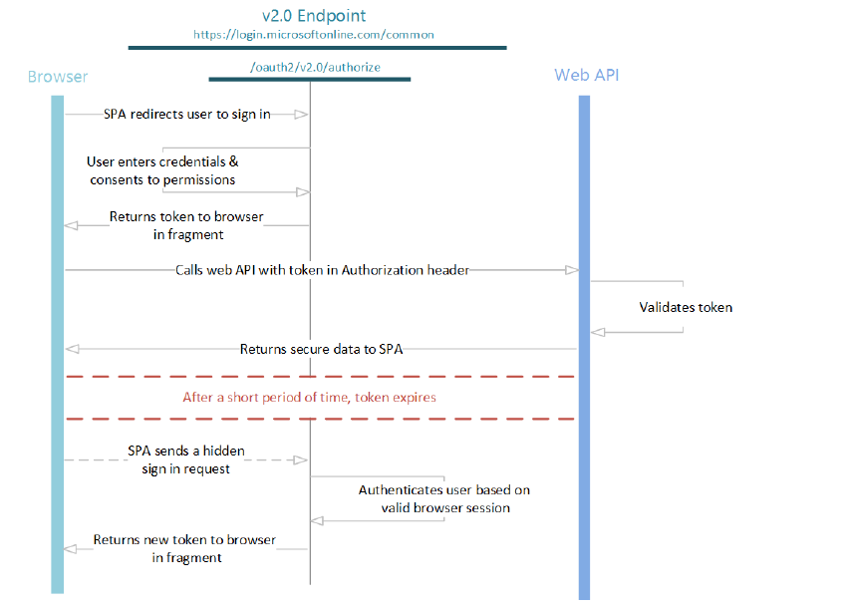
Azure AD Implicit Flow

Slide 21
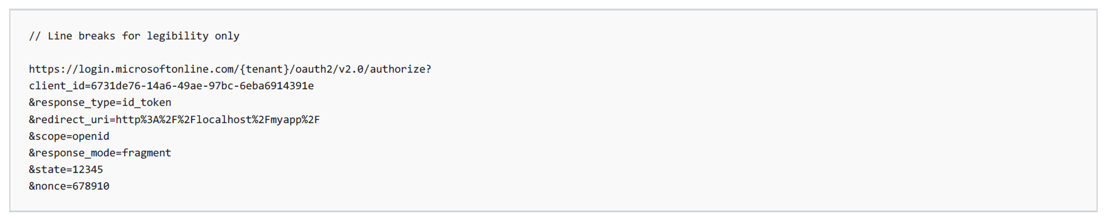
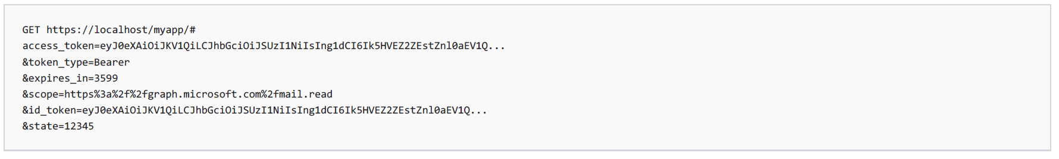
Azure AD Implicit Flow
response_type=id_token token
scope=include scopes requested for Token

Slide 22
https://joonasw.net/view/azure-ad-v2-and-msal-from-dev-pov
https://github.com/AzureAD/microsoft-authentication-library-for-dotnet/wiki/Adal-to-Msal
https://docs.microsoft.com/en-us/azure/active-directory/develop/sample-v2-code
https://github.com/AzureAD/microsoft-authentication-library-for-dotnet/wiki/scenarios
Manifest API: "accessTokenAcceptedVersion": 2
https://azure.microsoft.com/en-us/resources/samples/active-directory-dotnet-webapi-onbehalfof/
For the middle tier web API (TodoListService-OBO) to be able to call the downstream web APIs, the user must grant the middle tier permission to do so in the form of consent. However, since the middle tier has no interactive UI of its own, you need to explicitly bind the client app registration in Azure AD, with the registration for the web API. This binding merges the consent required by both the client & middle tier into a single dialog, which will be presented to the user by the client. You can do so by adding the "Client ID" of the client app, to the manifest of the web API in the knownClientApplications property.
https://medium.com/@darutk/diagrams-and-movies-of-all-the-oauth-2-0-flows-194f3c3ade85

Slide 23
Más información:
info@netcoreconf.com
@Netcoreconf
Visítanos en:
2019.Netcoreconf.com
GRACIAS

Slide 24
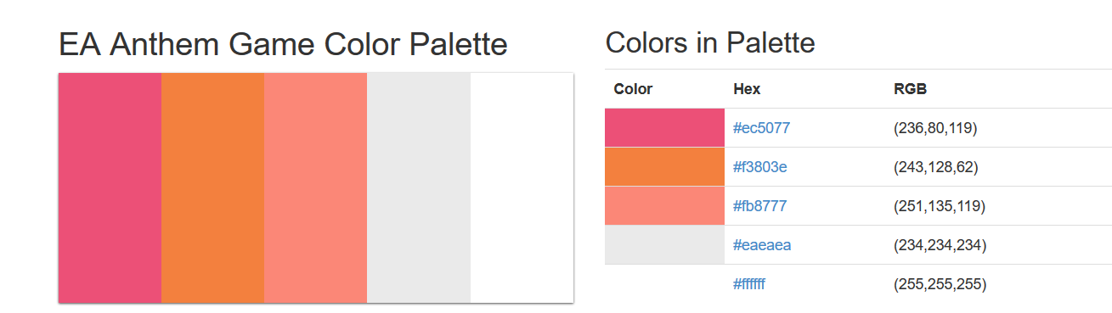

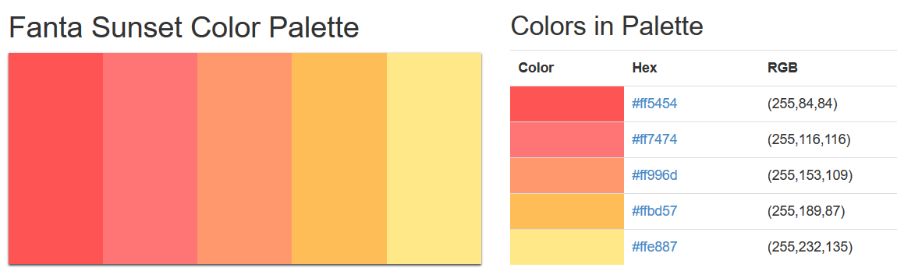
sambori
sam
bori
1
sambori
sambori
sambori
sambori
sambori
sambori
s
a
r
i
sambori
sambori
m
b
o
sambori
sambori
sambori
sambori
sambori
sambori

Slide 25
Open ID Connect (Sign in) Flow
OAuth 2.0 Auth code grant
OAuth 2.0 Implicit grant
Oauth 2.0 On-behalf-of
Oauth 2.0 Client Credentials
Oauth 2.0 Resource Owner password credentials grant

